Slide 1
Arrays

Slide 2
Arrays
Iteration allows computers to do the same thing many, many times
But we also need to be able to access large data structures to take advantage of this
There are many different data structures
Such as linked list, stacks, queues etc.
Arrays are the simplest
Essentially they enable us to declare and use variables of the same type en masse
Can allocate an array of 1000 integers in one go
Can access each one indirectly via a variable
Can use the loop control variable to access it.

Slide 3
Arrays
An array is an ordered list of values
The entire array
has a single name
Each value has a numeric index
0 1 2 3 4 5 6 7 8 9
scores
79 87 94 82 67 98 87 81 74 91
An array of size N is indexed from zero to N-1
This array holds 10 values that are indexed from 0 to 9

Slide 4
Arrays
A particular value in an array is referenced using the array name followed by the index in brackets
For example, the expression
scores[2]
refers to the value 94 (the 3rd value in the array)
That expression represents a place to store a single integer and can be used wherever an integer variable can be used
0 1 2 3 4 5 6 7 8 9
scores
79 87 94 82 67 98 87 81 74 91

Slide 5
Arrays
An array element can be assigned a value, printed, or used in a calculation
scores[2] = 89;
scores[first] = scores[first] + 2;
mean = (scores[0] + scores[1])/2;
System.out.println("Top = " + scores[5]);

Slide 6
Arrays
The values held in an array are called array elements
An array stores multiple values of the same type – the element type
The element type can be a primitive type or an object reference
Therefore, we can create an array of integers, an array of characters, an array of String objects, an array of Coin objects, etc.
In Java, the array itself is an object that must be instantiated

Slide 7
Declaring Arrays
The scores array could be declared as follows
int[] scores = new int[10];
Or equivalently
int[] scores;
scores = new int[10];
The type of the variable scores is int[] (an array of integers)
Note that the array type does not specify its size, but each object of that type has a specific size
The reference variable scores is set to a new array object that can hold 10 integers (index 0 to 9)

Slide 8
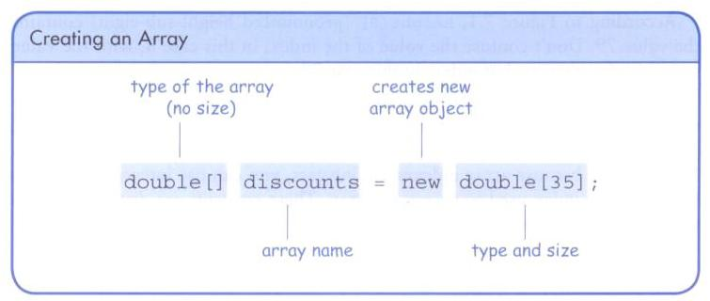
Declaring Arrays

Slide 9
Declaring Arrays
Some other examples of array declarations
float[] prices = new float[500];
boolean[] flags;
flags = new boolean[20];
char[] codes = new char[1750];

Slide 10
Using Arrays
The for-each loop can be used when processing array elements:
for (int score : scores)
System.out.println(score);
This is only appropriate when processing all array elements from the lowest index to the highest index
The for-each loop
for(variable to hold each value round the loop : array to process)
Equivalent for loop would be
for (int i=0; i<scores.length; i++)
System.out.println(score);

Slide 11
public class BasicArray
{
//-----------------------------------------------------------------
// Creates an array, fills it with various integer values,
// modifies one value, then prints them out.
//-----------------------------------------------------------------
public static void main(String[] args)
{
final int LIMIT = 15, MULTIPLE = 10;
int[] list = new int[LIMIT];
// Initialize the array values
for (int index = 0; index < LIMIT; index++)
list[index] = index * MULTIPLE;
list[5] = 999; // change one array value
// Print the array values
for (int value : list)
System.out.print(value + " ");
}
}

Slide 12
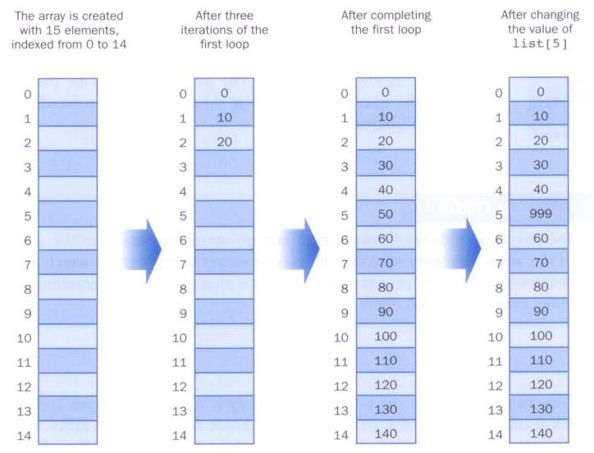
BasicArray Example

Slide 13
Bounds Checking
Once an array is created, it has a fixed size
An index used in an array reference must specify a valid element
That is, the index value must be in range 0 to N-1
The Java interpreter throws an ArrayIndexOutOfBoundsException if an array index is out of bounds
This is called automatic bounds checking

Slide 14
Bounds Checking
For example, if the array codes can hold 100 values, it can be indexed using only the numbers 0 to 99
If the value of count is 100, then the following reference will cause an exception to be thrown
System.out.println(codes[count]);
It’s common to introduce off-by-one errors when using arrays
problem
for (int index=0; index <= 100; index++)
codes[index] = index*50 + epsilon;

Slide 15
Bounds Checking
Each array object has a public constant called length that stores the size of the array
It is referenced using the array name
scores.length
Note that length holds the number of elements, not the largest index

Slide 16
import java.util.Scanner;
public class ReverseOrder
{
//-----------------------------------------------------------------
// Reads a list of numbers from the user, storing them in an
// array, then prints them in the opposite order.
//-----------------------------------------------------------------
public static void main(String[] args)
{
Scanner scan = new Scanner(System.in);
double[] numbers = new double[10];
System.out.println("The size of the array: " + numbers.length);
for (int index = 0; index < numbers.length; index++)
{
System.out.print("Enter number " + (index+1) + ": ");
numbers[index] = scan.nextDouble();
}
System.out.println("The numbers in reverse order:");
for (int index = numbers.length-1; index >= 0; index--)
System.out.print(numbers[index] + " ");
}
}

Slide 17
Initializer Lists
An initializer list can be used to instantiate and fill an array in one step
The values are delimited by braces and separated by commas
Examples:
int[] units = {147, 323, 89, 933, 540,
269, 97, 114, 298, 476};
char[] letterGrades = {'A', 'B', 'C', 'D', ’F'};

Slide 18
Initializer Lists
Note that when an initializer list is used
the new operator is not used
no size value is specified
The size of the array is determined by the number of items in the initializer list
An initializer list can be used only in the array declaration

Slide 19
// Demonstrates the use of an initializer list for an array.
//********************************************************************
public class Primes
{
//-----------------------------------------------------------------
// Stores some prime numbers in an array and prints them.
//-----------------------------------------------------------------
public static void main(String[] args)
{
int[] primeNums = {2, 3, 5, 7, 11, 13, 17, 19};
System.out.println("Array length: " + primeNums.length);
System.out.println("The first few prime numbers are:");
for (int prime : primeNums)
System.out.print(prime + " ");
}
}

Slide 20
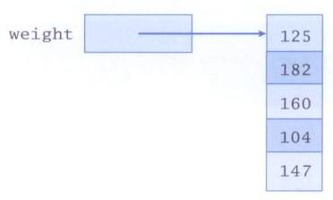
Arrays of Objects
An array is an object and an array can hold objects as elements
The array name is an object reference variable
So this is another way to depict an array:

Slide 21
Arrays of Objects
An array of objects really holds object references
The following declaration reserves space to store 5 references to String objects
String[] words = new String[5];
It does not create the String objects themselves
Initially an array of objects holds null references
Each object stored in an array must be instantiated separately
Possibly using a loop

Slide 22
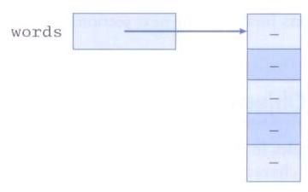
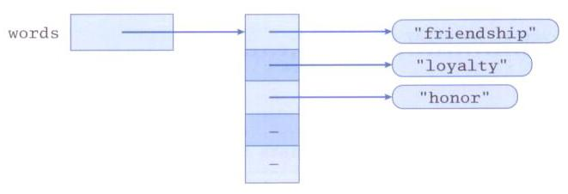
Arrays of Objects
After initial creation, an array holds null references:
Each element is a reference
to an object:

Slide 23
Arrays of Objects
Keep in mind that String objects can be created using literals
The following declaration creates an array object called verbs and fills it with four String objects created using string literals
String[] verbs = {"play", "work", "eat", "sleep"};
...

